Slide 1

Programming Fundamental
Week 13
Sobia Iftikhar
Sobia.Iftikhar@nu.edu.pk

Slide 2
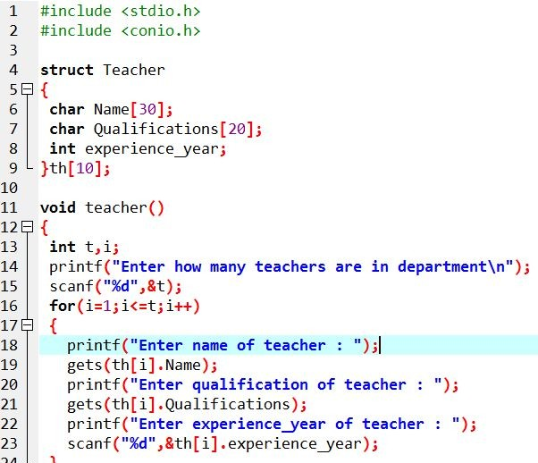
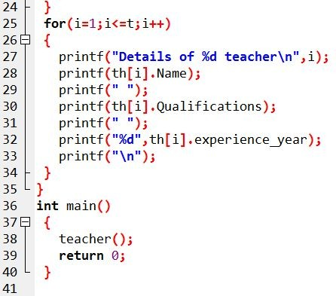
gets & puts with array structure in c

Slide 3
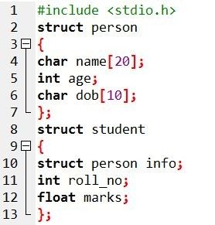
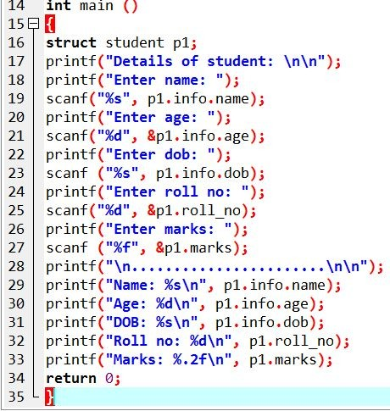
Nested structure in C

Slide 4
Nested structure
Nested structure in C is nothing but structure within structure. One structure can be declared inside other structure as we declare structure members inside a structure.
The structure variables can be a normal structure variable or a pointer variable to access the data. You can learn below concepts in this section.
Structure within structure in C using normal variable
Structure within structure in C using pointer variable

Slide 5

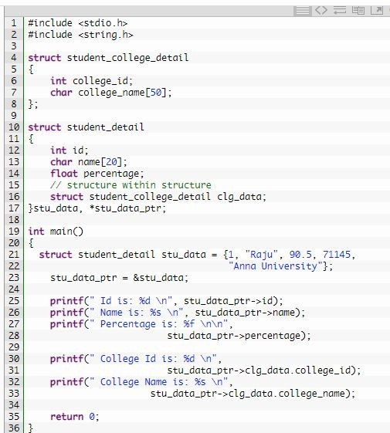
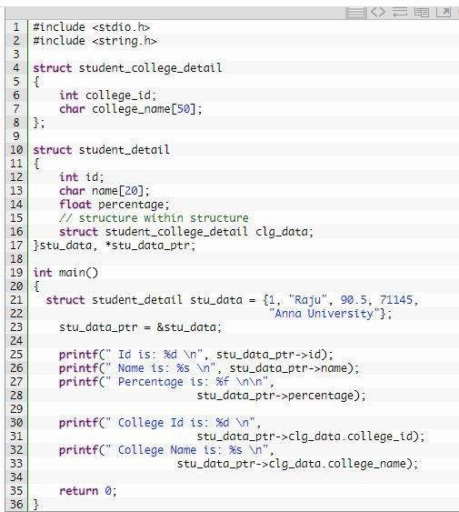
Nested structure

Slide 6
struct student { char name[50]; int age;
};
// function prototype
void display(struct student s);
int main() {
struct student s1;
printf("Enter name: ");
Passing structs to
// read string input from the user until \n is entered
// \n is discarded scanf("%[^\n]%*c", s1.name);
functions
pass struct variables as arguments to a
function. You will learn to return struct
from a function with the help of
examples.
printf("Enter age: "); scanf("%d", &s1.age);
display(s1); // passing struct as an argument return 0;
}
void display(struct student s) { printf("\nDisplaying information\n"); printf("Name: %s", s.name);
printf("\nAge: %d", s.age);
}

Slide 7
struct student
{
char name[50]; int age;
};
// function prototype
struct student getInformation();
int main()
{
struct student s;
Return struct from a
function
s = getInformation();
printf("\nDisplaying information\n"); printf("Name: %s", s.name);
printf("\nRoll: %d", s.age);
return 0;
}
struct student getInformation()
{
struct student s1;
printf("Enter name: ");
scanf ("%[^\n]%*c", s1.name);
printf("Enter age: "); scanf("%d", &s1.age);
return s1;
pass struct variables as arguments to a
function. You will learn to return struct
from a function with the help of
examples.

Slide 8


Pointers?
A pointer is a variable whose value is the address of another variable, i.e., direct address of the memory location. Like any
variable or constant, you must declare a pointer before using it to store any variable address

Slide 9
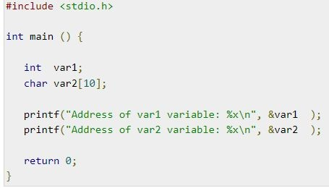

pointers

Slide 10

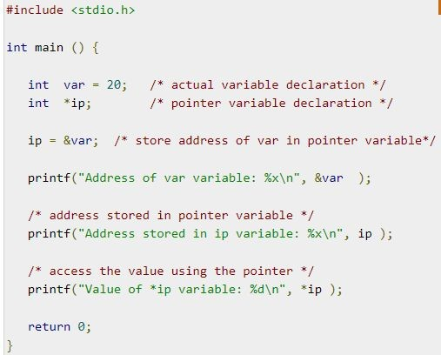

Pointers-Example

Slide 11
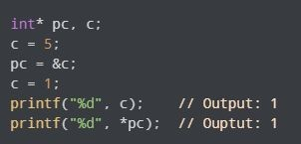
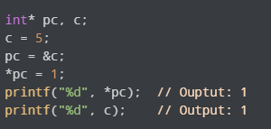
Changing Value Pointed by PointeR
We have assigned the address of c to the pc pointer.
Then, we changed the value of c to 1. Since pc and the address of c is the same, *pc gives us 1.
We have assigned the address of c to the pc pointer.
Then, we changed *pc to 1 using *pc = 1;. Since pc and the address of c is the same, c will be equal to 1.

Slide 12
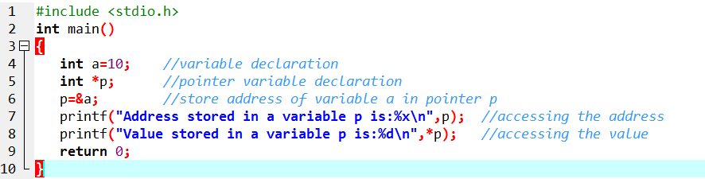
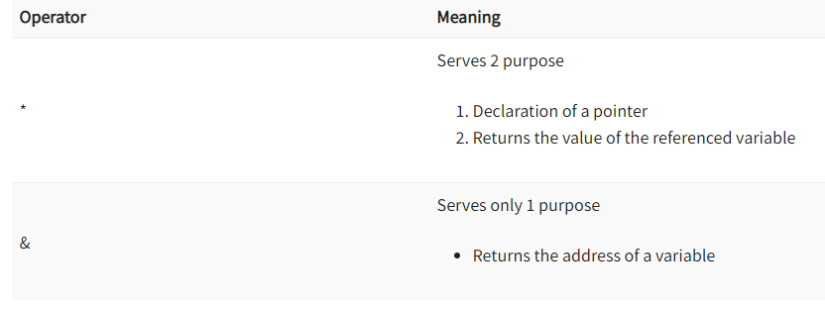
Example

Slide 13
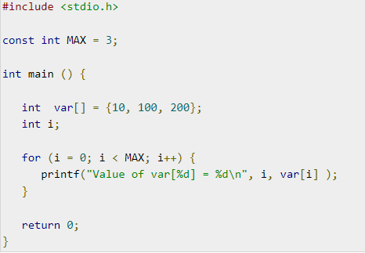
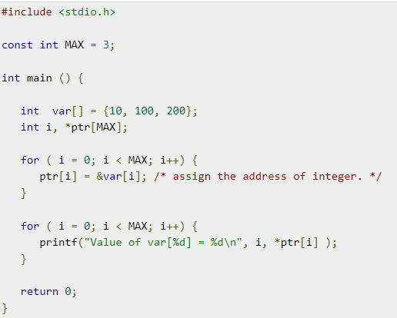


Pointer Array

Slide 14
Types of Pointer
Null pointer
Void pointer
Wild Pointer

Slide 15


Null Pointer
A null pointer means it is not pointing to anything. If, there is no address that is assigned to a pointer, then set it to null.
A pointer type, i.e., int *, char * each have a null pointer value.
#include<stdio.h>
int main(){
printf(" C Programming");
int *p = NULL; // ptr is a NULL pointer
printf("\n The value of pointer is: %x ", p);
return 0;
}

Slide 16

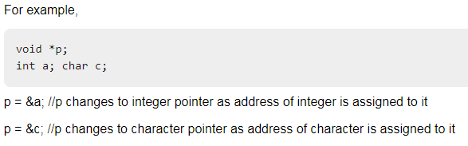
Void Pointer
A void pointer is nothing but the one who does not have any data type with it. It is also called as a general purpose pointer. It can hold the addresses of any data type.
int main(){
int a = 10;
void *ptr = &a;
printf("%d", *(int *)ptr);
return 0;
}

Slide 17
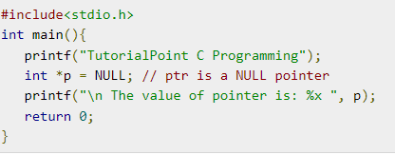
Null Pointer
A null pointer means it is not pointing to anything. If, there is no address that is assigned to a pointer, then set it to null.
A pointer type, i.e., int *, char * each have a null pointer value.

Slide 18
Thankyou

